Slide 1
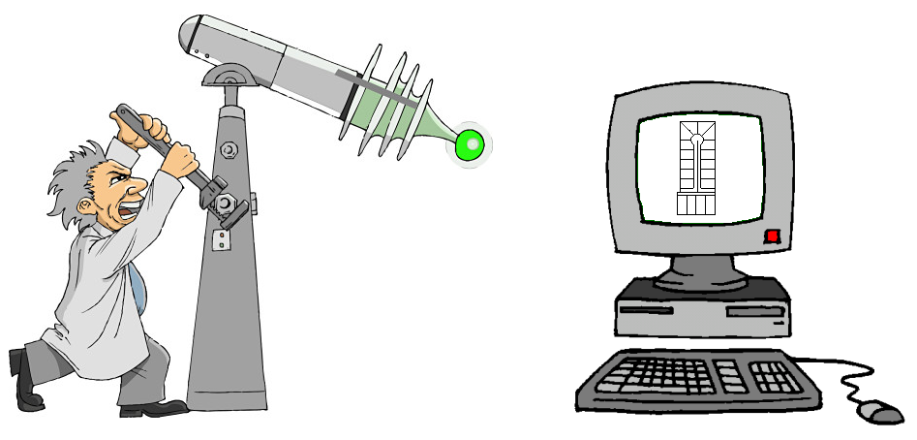
CONCOCTING A GIS PART II
Jim Isbell, Engineering Tech. II
Kern County Assessor’s Office
(661) 868-3376 | isbellj@co.kern.ca.us

Slide 2
INSPIRATION (BLAME)
Shasta County Assessor’s CAD/GIS, 2004
Pre-conference seminar, 2005 ESRI User Conference: “Cartography: Modeling GIS Data for Mapmaking”
Santa Cruz County Assessor’s GIS, 2005
Los Angeles County Assessor’s GIS, 2007
ESRI Coverage format
Sidwell Parcel Builder

Slide 3
STAFF & STUFF WE STARTED WITH
ArcGIS (1 ArcInfo, 4 ArcEditors).
Server, ArcSDE, SQL Server in GIS dept.
Ambitious staff
One who is fairly proficient in ArcGIS and VB
One who is a logical, big-picture thinker
Three to cover our backs and take up the slack
All 5 well-versed in AutoCAD

Slide 4
DATA WE STARTED WITH
3300 CAD drawings (16900 maps total)
Polygon shapefile of land parcels
Converted polygons to lines
Generated parcel points (centroids) with APN
Section corners (Engineering Dept.)

Slide 5
COST OF CONCOCTING
After a year-and-a-half, we estimate:
Thanks to slow economy!!!
1920 man-hours of development time
About $55,000 in county wages
Compared to $288,000 in consultant fees

Slide 6
DEMO

Slide 7
QUESTIONS???
Jim Isbell, Engineering Tech. II
Kern County Assessor / Mapping
(661) 868-3376 | isbellj@co.kern.ca.us
Mark Larner, Engineering Tech. I
Kern County Assessor / Mapping
(661) 868-3378 | larner@co.kern.ca.us
Notes:
Tightly interwoven

