Slide 1
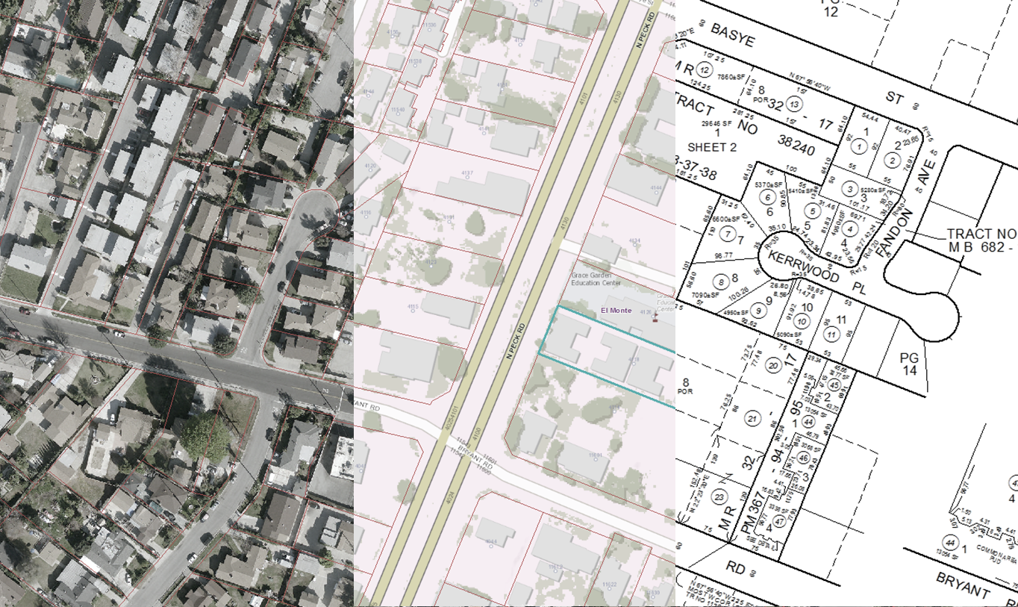
…instead of Parcel Fabric
CCMA 2015 Conference, South Lake Tahoe
Land base management
using a Geodatabase
Presented by: Emilio Solano, Supervising Cadastral Engineer III

Slide 2
Topics
Why Geodatabase?
Why not Parcel Fabric?
Training
Tracking job assignments
Map production overview
Questions

Slide 3
Topics
Why Geodatabase?
Why not Parcel Fabric?
Training
Tracking job assignments
Map production overview
Questions

Slide 4
Why Geodatabase?
45.2
3
TR 12345
Simple design having little or no dependency on the format of the software needed to produce the map.
This method has proven to be effective and highly portable

Slide 5
Why Geodatabase?
boundaries
parcels
topology

Slide 6
Why Geodatabase?
Must not have dangles
Must not intersect or touch interior
Must not self overlap
Must not self intersect
Must be single part
Parcel boundary must be covered by Boundaries

Slide 7
Why Geodatabase?
Tax Parcels
Boundaries
Angle
Distance
Radius
Delta
Tangent
Arclength
Side
Layer
Show_on_Index
Parcels
AIN
Parcel_type
LastUpdate
Editorname
GlobalID
Tract
PM_Ref
Phase
Block
Lot
Unit_No
Tot_Units
TRA
SubdType
PclType
Topology
Boundaries:
Must Not Self-Overlap
Must Not Self-Intersect
Must Not Have Dangles
Must Be Single Part
Must Not Intersect or Touch Interior
Parcels:
Boundary Must Be Covered By Boundaries

Slide 8
Why Geodatabase?
We also included other feature data sets in our landbase:
Assessor Districts
Map books
Map book pages
Clusters
Communities
District offices
Regions
Marinas
Docks
Vessels
Photos
Manufactured Homes
Parks
Units
Tax Rate Areas
Areas
Applications
Web
Mobile
Canvassing
Field Books
Offices
These are replicated to the LA County eGIS Data Repository

Slide 9
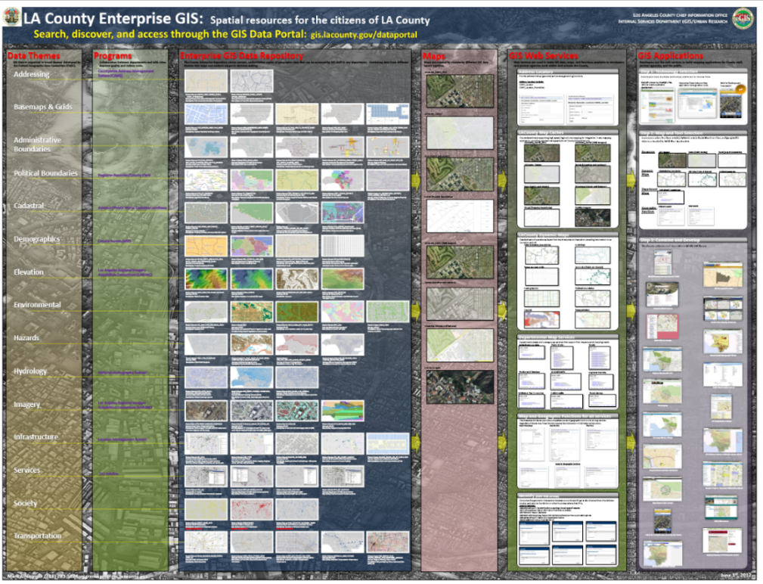
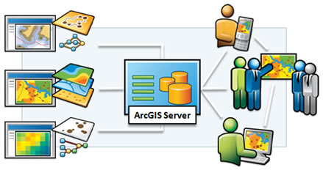
Why Geodatabase?
And are available to all County departments and many cities
The data is organized in 14 themes containing
63 datasets with more than 400 feature layers

Slide 10
Topics
Why Geodatabase?
Why not Parcel Fabric?
Training
Tracking job assignments
Map production overview
Questions

Slide 11
Why not Parcel Fabric?
To use or not to use… That’s the question

Slide 12
Why not Parcel Fabric?
Current Issues
Database Size
Plotting
Data exchange/sharing

Slide 13
Why not Parcel Fabric?
Database size
Landbase

Slide 14
Why not Parcel Fabric?
Database size
Parcels
AIN
Parcel_type
LastUpdate
Editorname
GlobalID
Tract
PM_Ref
Phase
Block
Lot
Unit_No
Tot_Units
TRA
SubdType
PclType
Boundaries
Angle
Distance
Radius
Delta
Tangent
Arclength
Side
Layer
Show_on_Index
? ? ?

Slide 15
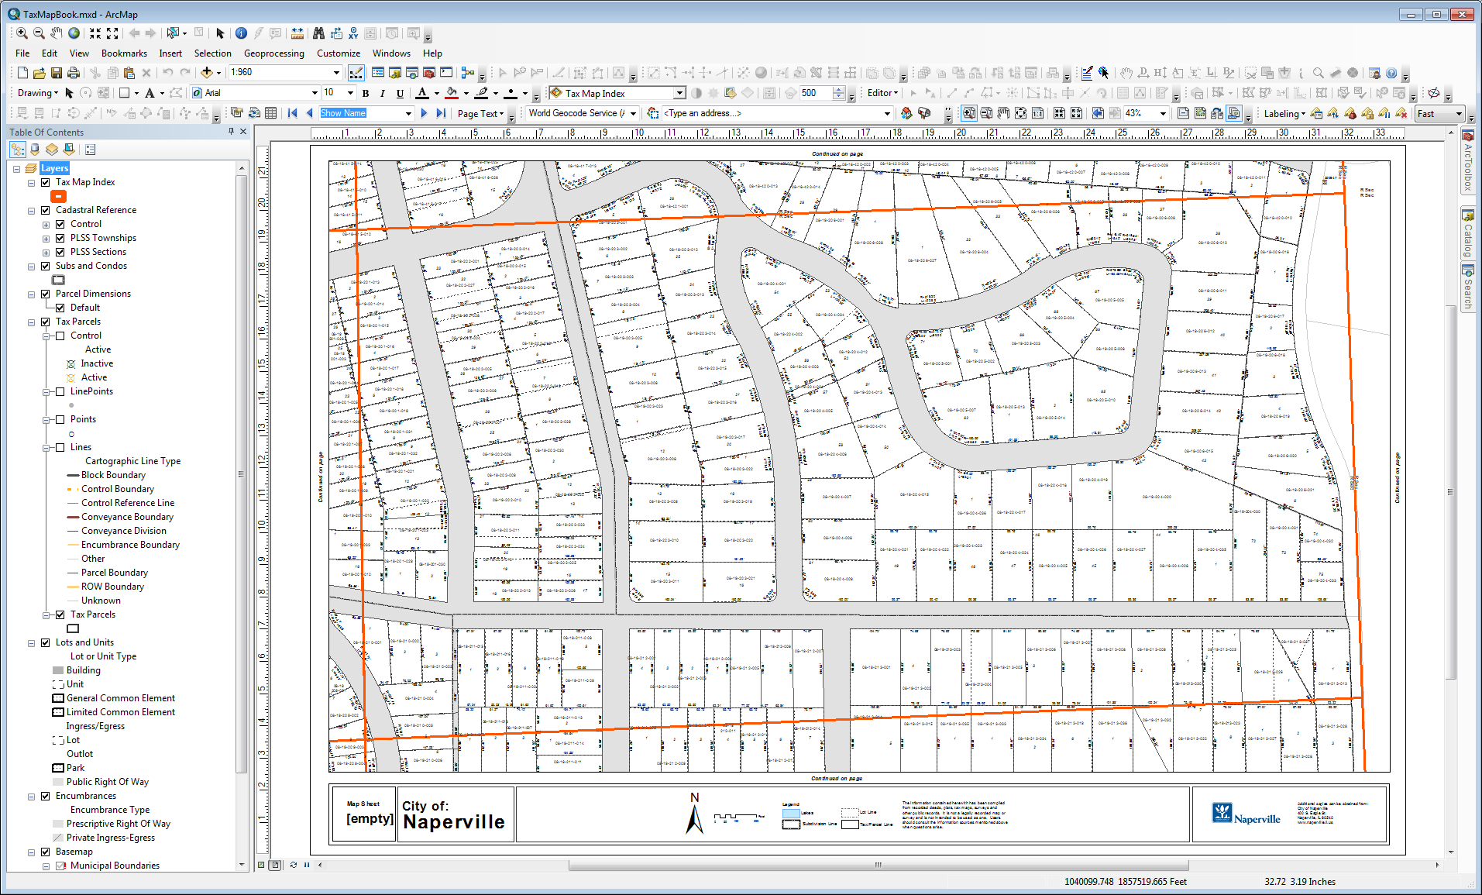
Why not Parcel Fabric?
Plotting

Slide 16
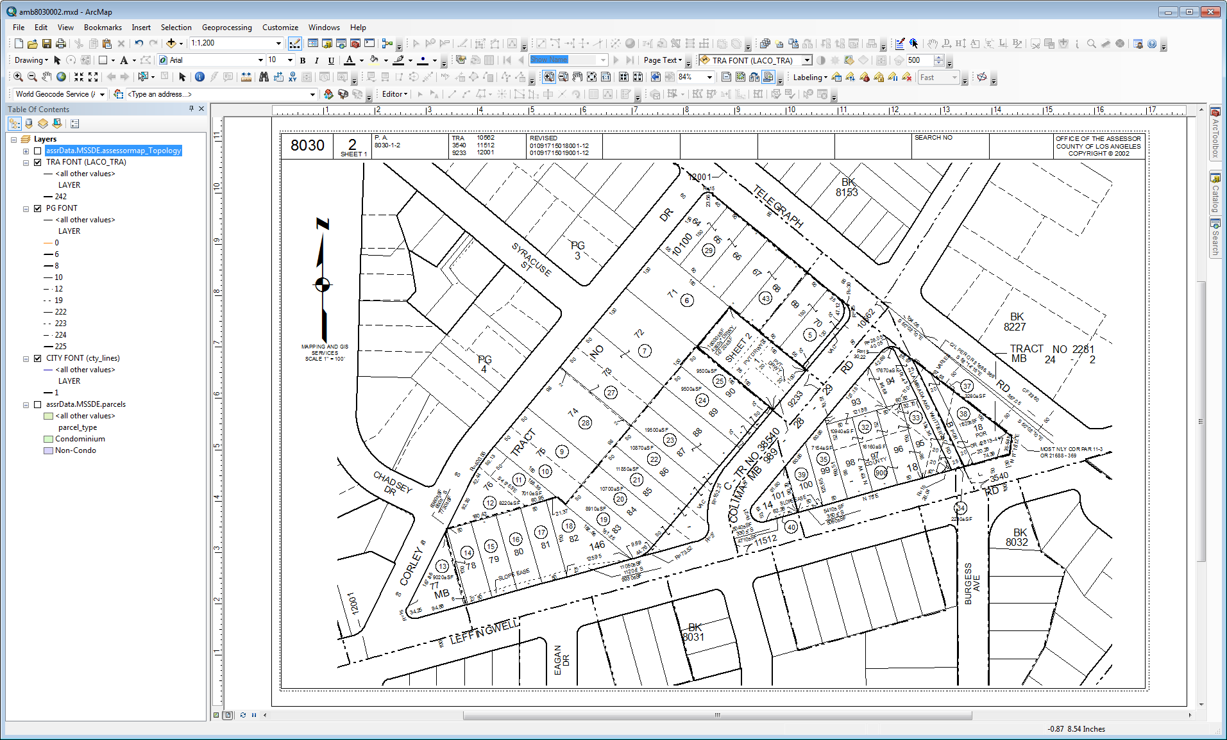
Why not Parcel Fabric?
Plotting

Slide 17
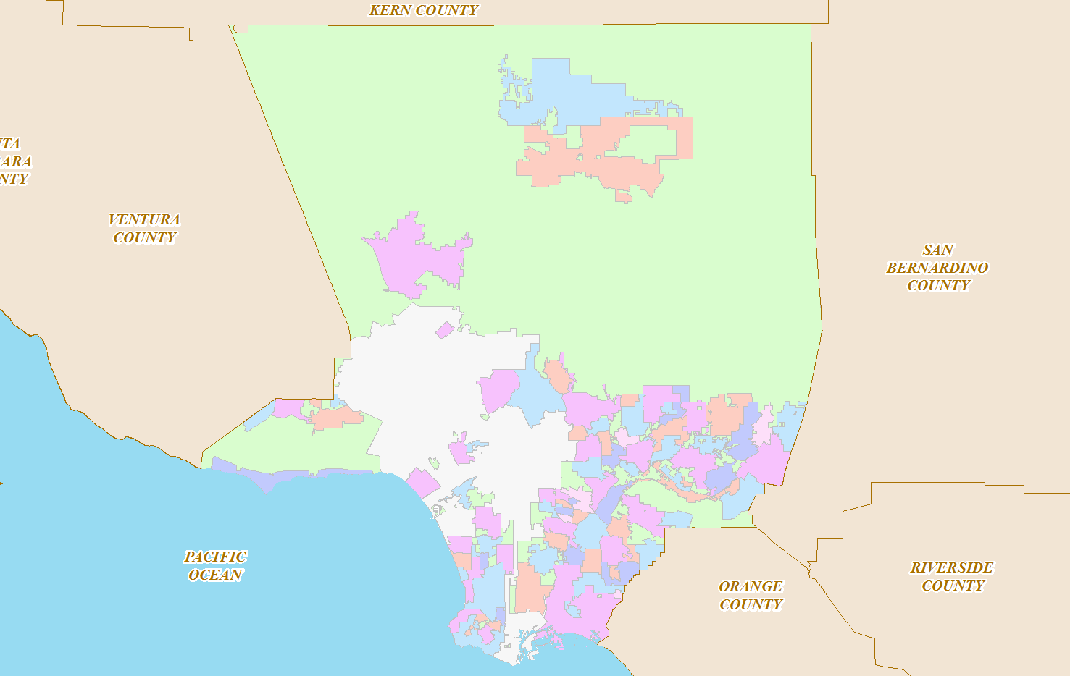
Why not Parcel Fabric?
County Depts.
Private Agencies
Others
State Agencies
Cities
Data exchange/sharing

Slide 18
Why not Parcel Fabric?
Just apply the fabric…

Slide 19
Why not Parcel Fabric?
Eeny, meeny, miny, moe!

Slide 20
Topics
Why Geodatabase?
Why not Parcel Fabric?
Training
Tracking job assignments
Map production overview
Questions

Slide 21
Training
Mapping & GIS Services
Mapping Training
(In-house, to our staff)
Ownership Training
(Property description interpretation)
GIS for Mappers
(In-house, to our staff)
Appraisal Training
(Introduction to mapping)
Other Counties
(Mapping & GIS through classes & conferences)

Slide 22
Training
Eagerness

Slide 23
Training
Concentration

Slide 24
Training
Relaxing

Slide 25
Training
Enthusiasm

Slide 26
Training
Accomplishment

Slide 27
Topics
Why Geodatabase?
Why not Parcel Fabric?
Training
Tracking job assignments
Map production overview
Questions

Slide 28
Tracking Job Assignments
Mapping & GIS Services
Registrar
Recorder
LAFCO
SBE
Property Owners
County and Local Agencies

Slide 29
Tracking Job Assignments
Incoming
Production
Checking

Slide 30
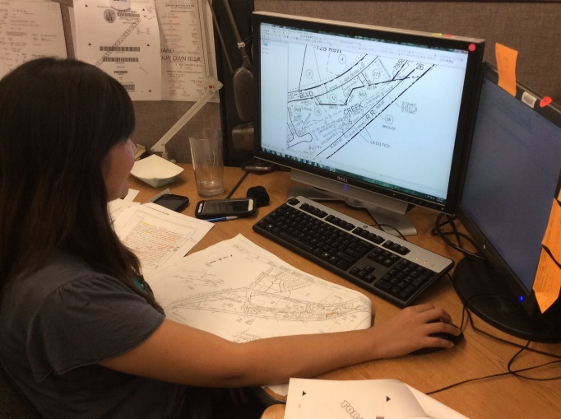
Tracking Job Assignments
Engineer
Spot Checking
Checking
Engineer Duties:
Review documents
Verify information
Investigate
Resolve issues
Produce/correct maps
Engineer
Supervisor
Checking

Slide 31
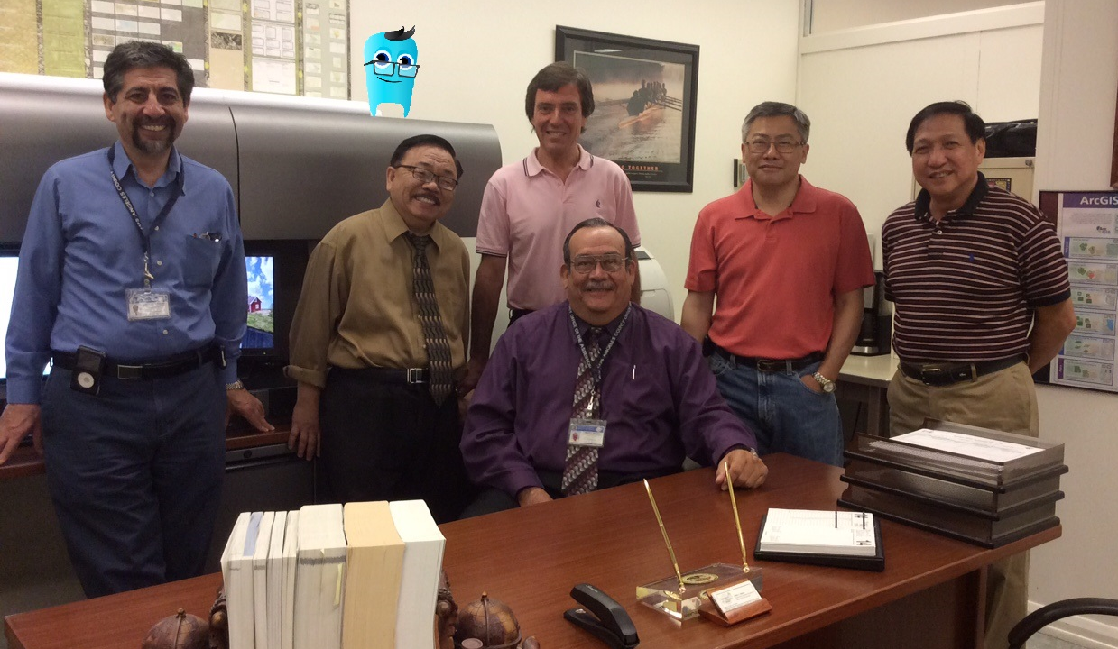
Tracking Job Assignments
Mapping & GIS Services’ Joint Chiefs of Staff

Slide 32
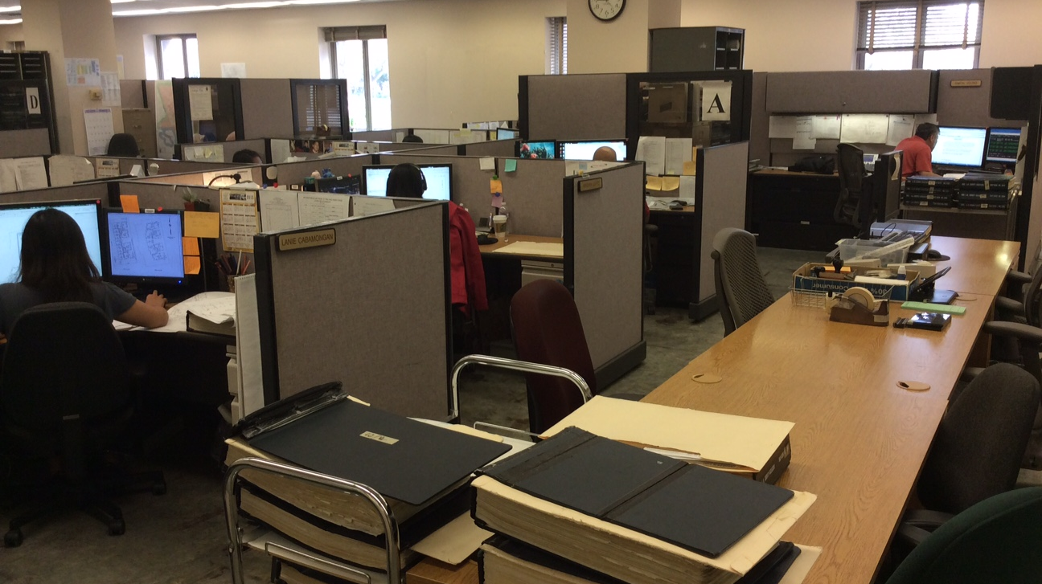
Tracking Job Assignments
Mapping & GIS Services’ Production Unit A

Slide 33
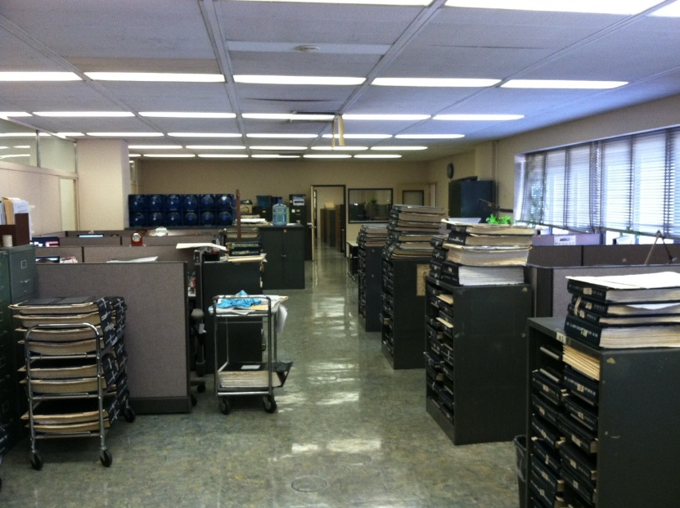
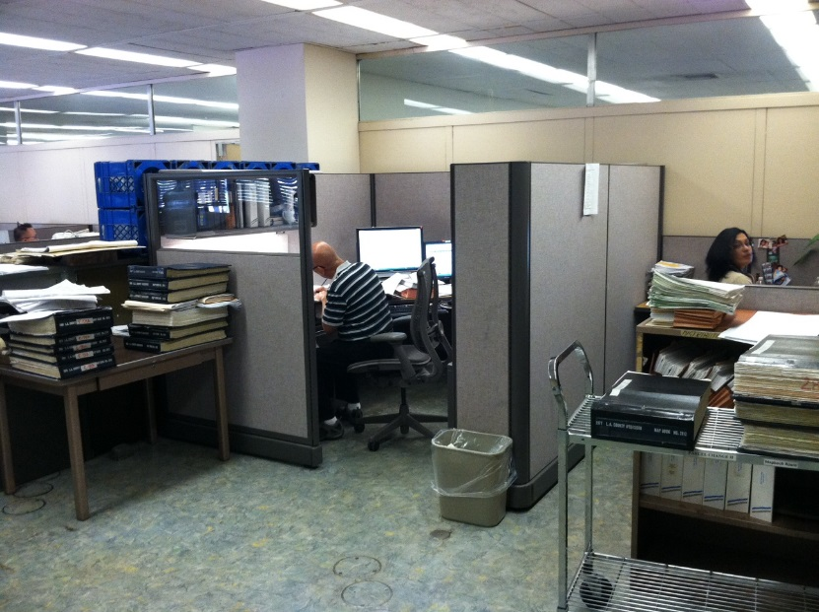
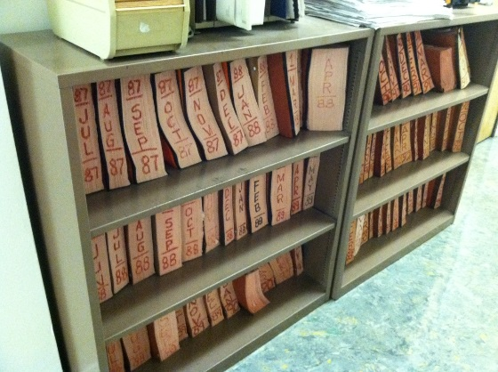
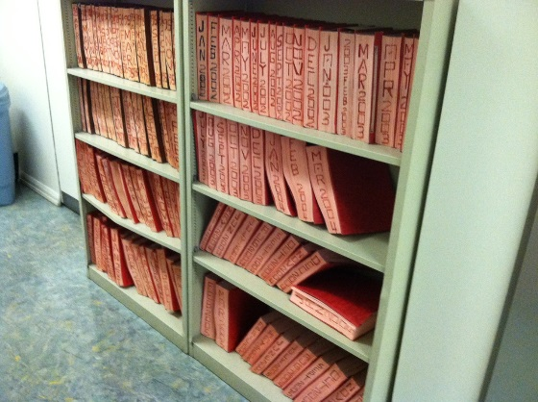
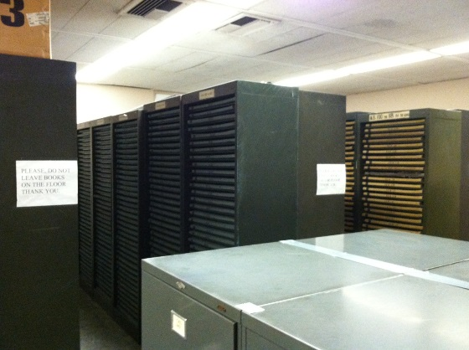
Tracking Job Assignments
Mapping & GIS Services’ Checking and TRA Unit, File Room

Slide 34
Topics
Why Geodatabase?
Why not Parcel Fabric?
Training
Tracking job assignments
Map production overview
Questions

Slide 35
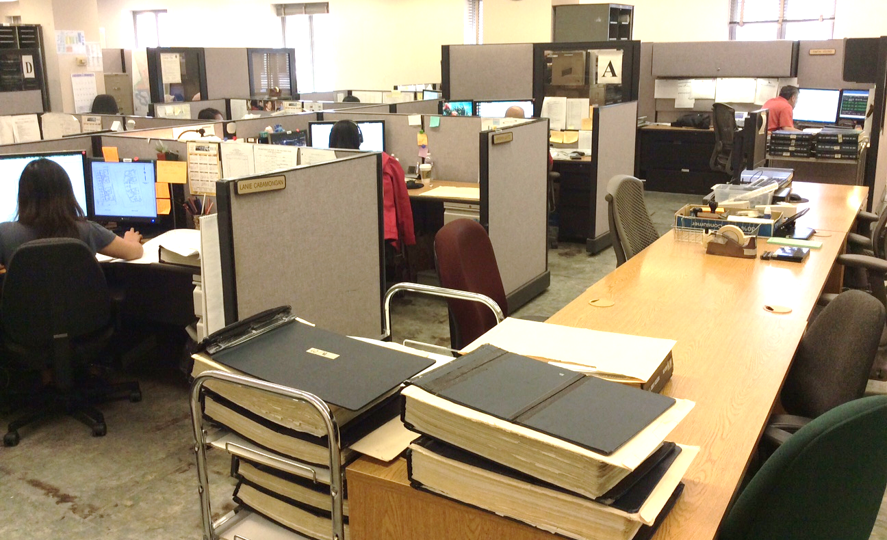
Map production Overview
Typical workflow:
Add datasets to the template (Parcels and TRA)
2. Select data for page to work (AIN like ‘2004005%’)
3. Complete the title box (AMB, page, TRA, IDs)
4. Save mxd, export to PDF and print

Slide 36
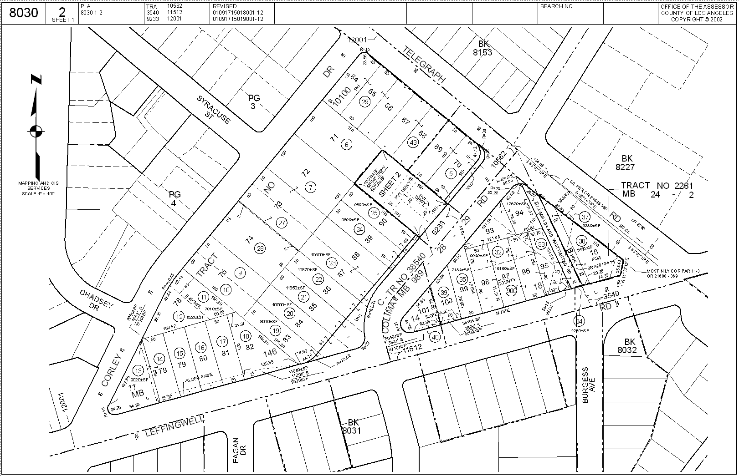
Map production Overview

Slide 37
Map production Overview
This is fine, but…
What about condominiums?
Must not have dangles
Must not intersect or touch interior
Must not self overlap
Must not self intersect
Must be single part
Parcel boundary must be covered by Boundaries

Slide 38
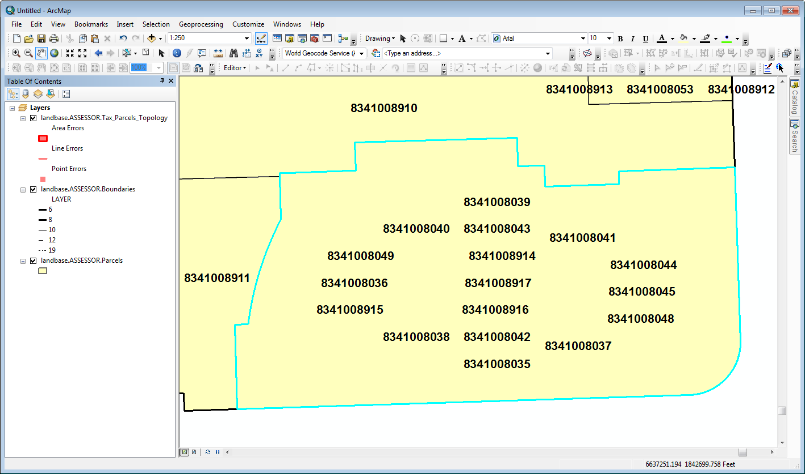
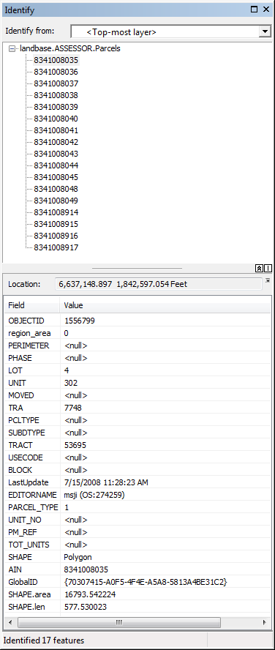
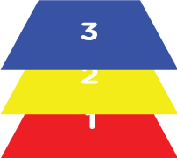
Map production Overview
One polygon per parcel
(each condominium unit = one parcel)

Slide 39
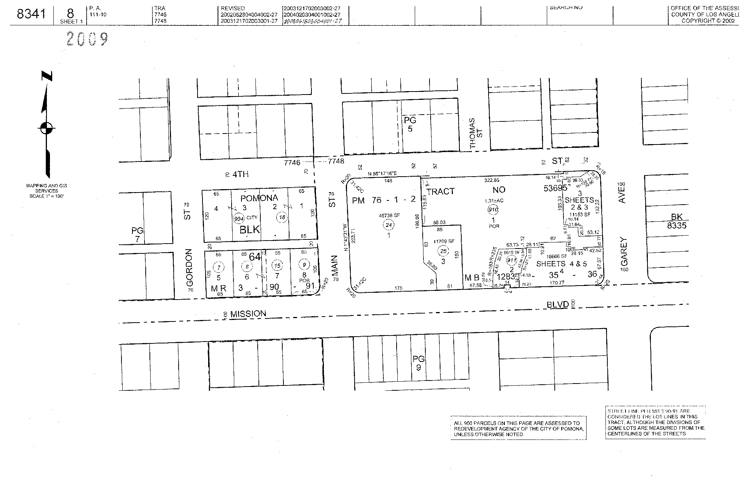
Map production Overview
Landbase.ASSESSOR.Tax_Parcels

Slide 40
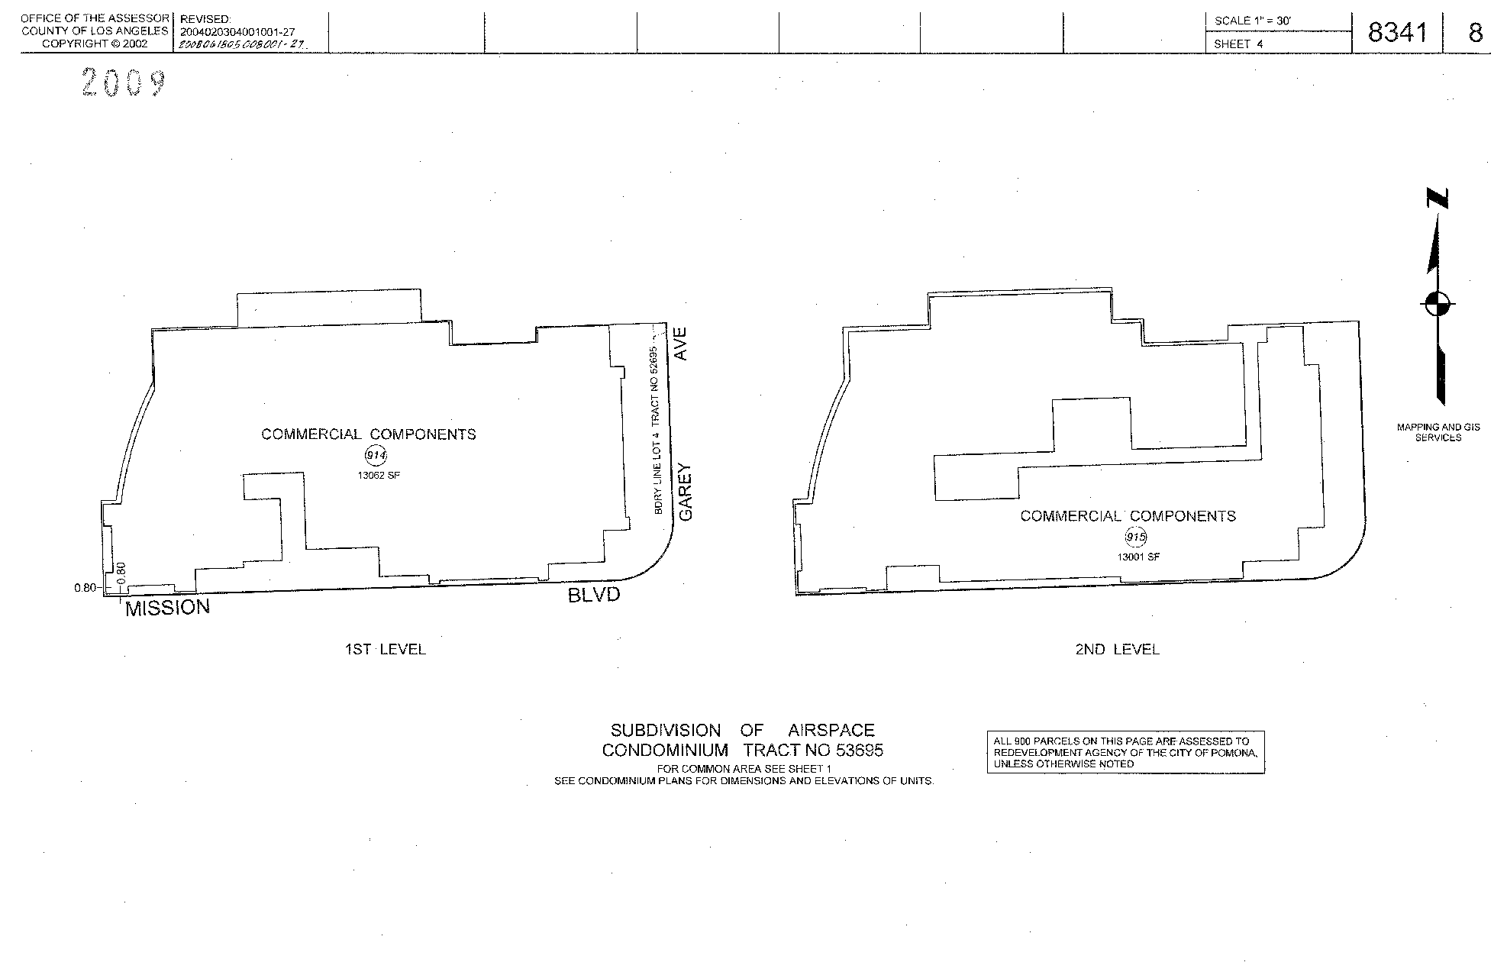
Map production Overview
TR 53695-4 RL.mdb

Slide 41
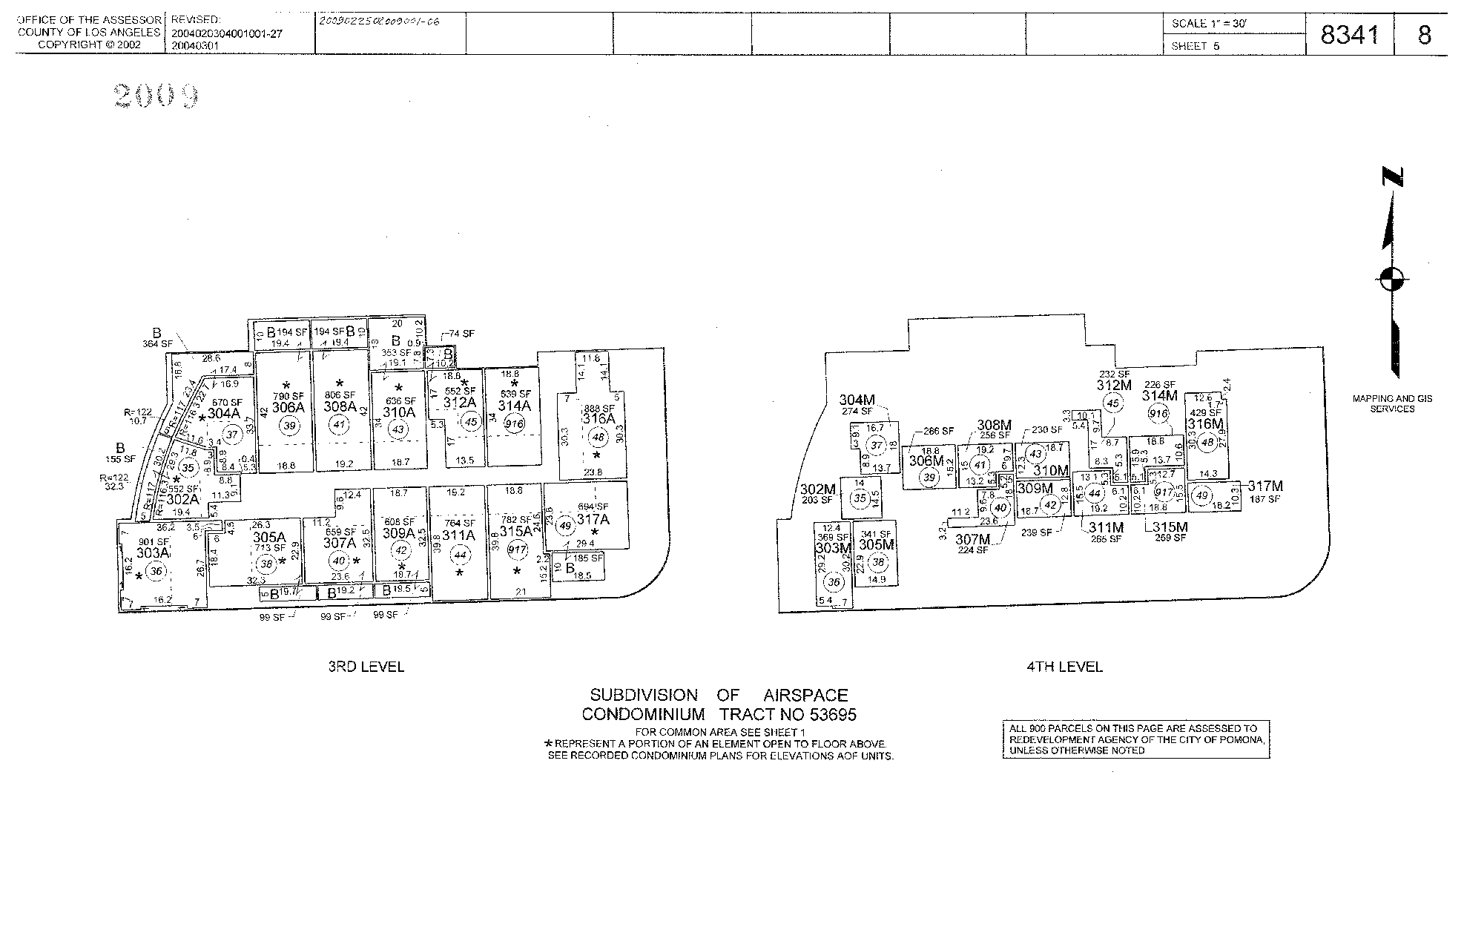
Map production Overview
TR 53695-5 RL.mdb

Slide 42
Map production Overview
M&GS’ Parcel Viewer
http://egis3.lacounty.gov/parcelviewer_public

Slide 43
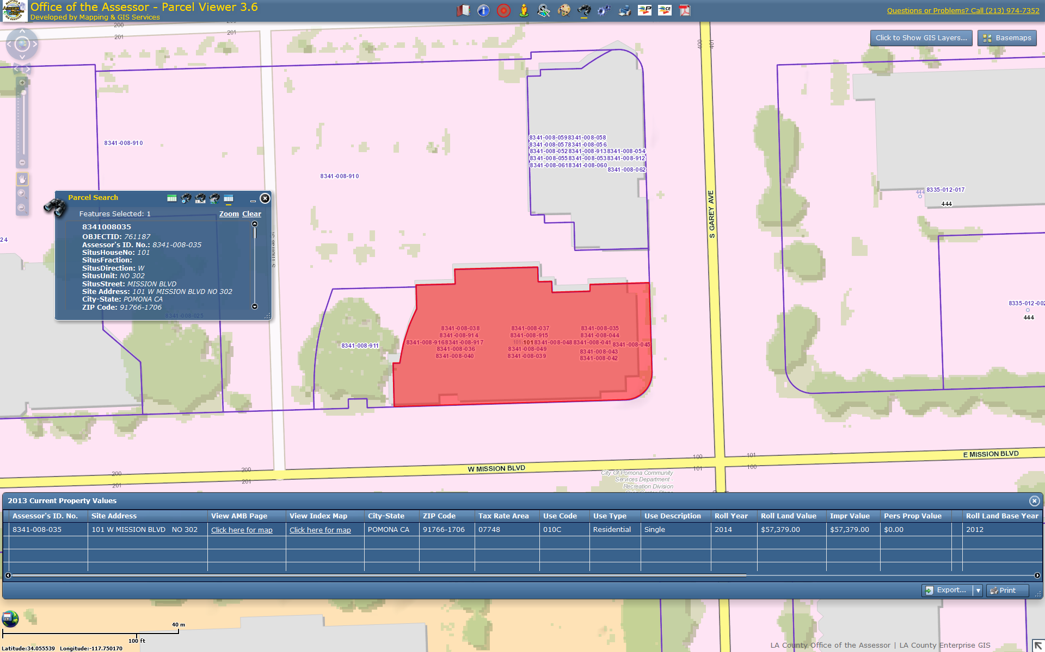
Map production Overview

Slide 44
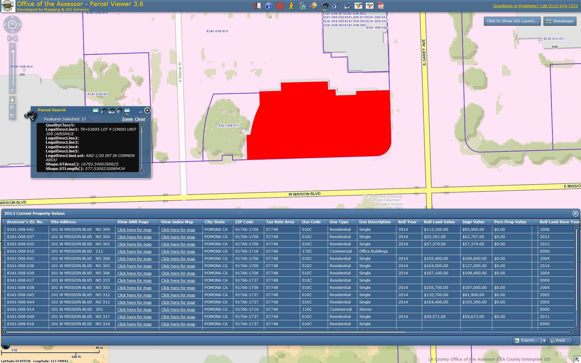
Map production Overview

Slide 45
Map production Overview
First Level:
Parcel: 914

Slide 46
Map production Overview
Second Level:
Parcel: 915

Slide 47
Map production Overview
Third Level:
Parcels: 35 to 45, 48, 49, 916 & 917

Slide 48
Map production Overview
Fourth Level:
Parcels: 35 to 45, 48, 49, 916 & 917

Slide 49
Map production Overview

Slide 50
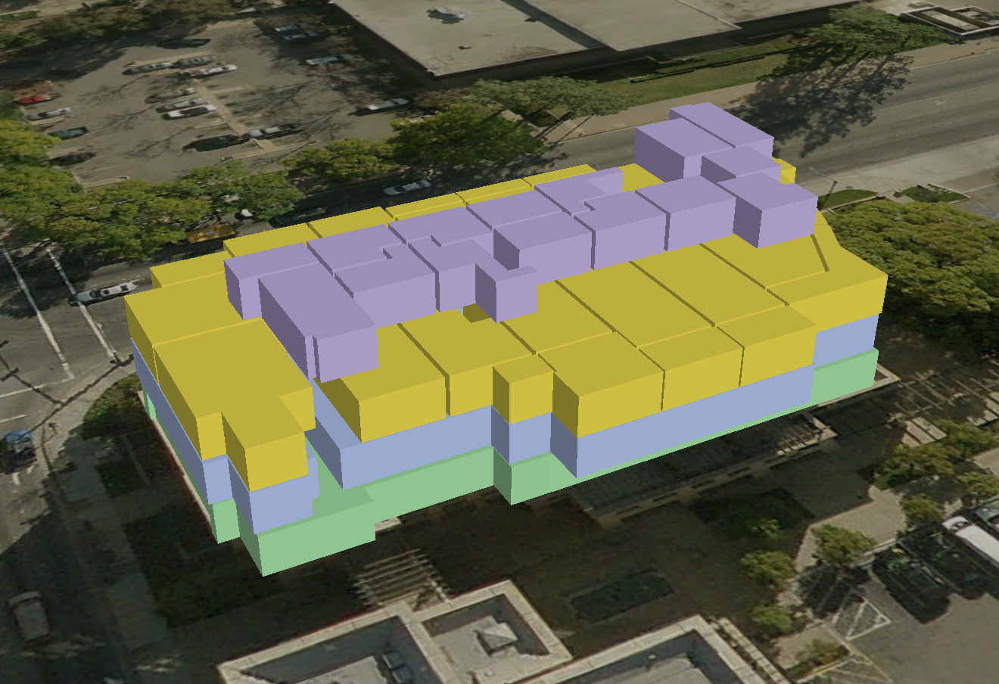
Map production Overview

Slide 51
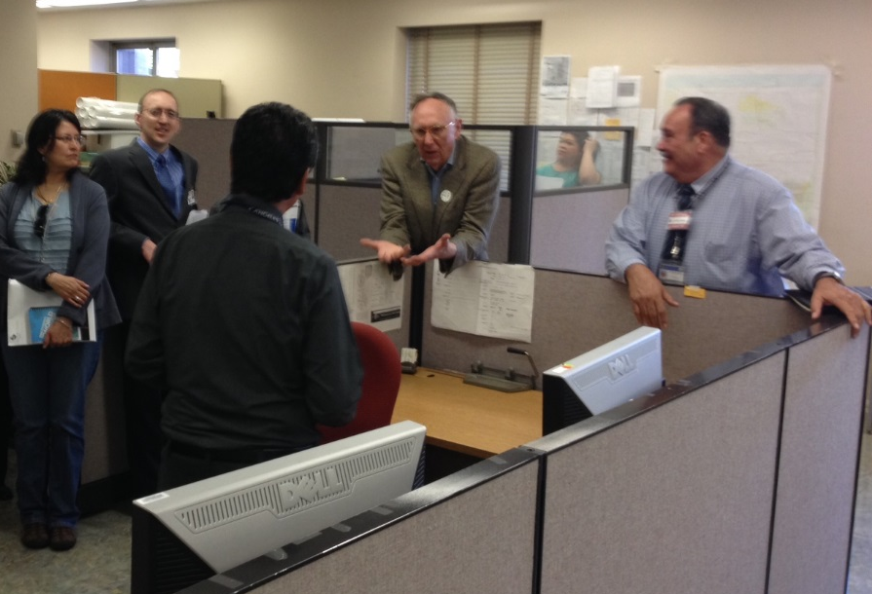
Questions
Jack visiting Mapping on GIS Day 2014
Jack & GIS Day 2014 Exec Team

